Slide 1

Customer Shopping Behavior Analysis
This project analyzes customer shopping behavior using transactional data from 3,900 purchases. Our goal is to uncover insights into spending patterns, customer segments, product preferences, and subscription behavior to guide strategic business decisions.

Slide 2

Project Overview
Data-Driven Insights
Strategic Decisions
Analyzing 3,900 purchases to understand customer behavior.
Guiding business choices with insights into spending patterns and preferences.
Key Areas
Focus on customer segments, product preferences, and subscription behavior.

Slide 3

Dataset Summary
Key Features
Customer demographics (Age, Gender, Location, Subscription Status)
Purchase details (Item, Category, Amount, Season, Size, Color)
Shopping behavior (Discount, Promo Code, Previous Purchases, Frequency, Review Rating, Shipping Type)
Missing Data: 37 values in Review Rating column.

Slide 4
Exploratory Data Analysis (Python)
01
02
03
Data Loading & Exploration
Missing Data Handling
Column Standardization
Imported dataset with pandas; checked structure and summary statistics.
Imputed missing 'Review Rating' values using median per product category.
Renamed columns to snake_case for improved readability.
04
05
Feature Engineering
Database Integration
Created 'age_group' and 'purchase_frequency_days' columns.
Loaded cleaned data into PostgreSQL for SQL analysis.

Slide 5


Data Analysis using SQL: Key Findings
Revenue by Gender
Male customers generated higher revenue ($157,890) than female customers ($75,191).
Top 5 Products by Rating
Gloves, Sandals, Boots, Hat, and Skirt had the highest average review ratings.
Shipping Type
Express shipping had a slightly higher average purchase amount ($60.48) than Standard ($58.46).

Slide 6
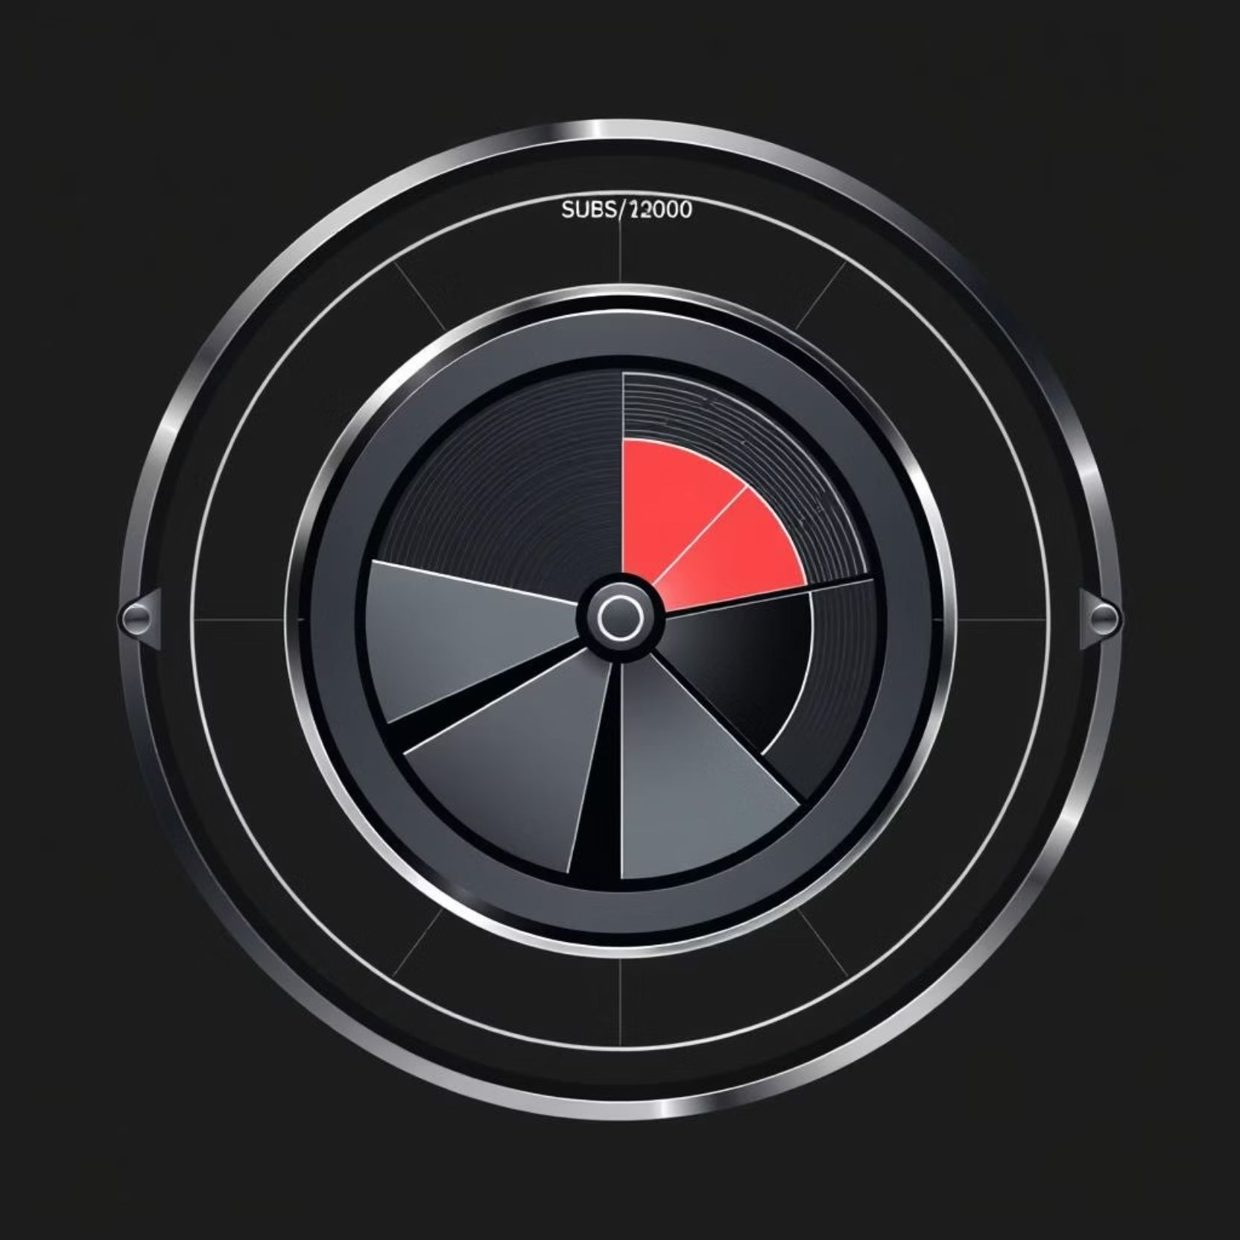
SQL Insights: Customer Behavior
Subscribers vs. Non-Subscribers
Non-subscribers (2847) contributed more total revenue ($170,436) than subscribers (1053, $62,645).
Discount-Dependent Products
Hat (50%), Sneakers (49.66%), and Coat (49.07%) had the highest percentage of discounted purchases.

Slide 7



Customer Segmentation & Loyalty
Loyal
1
3116 Customers
Returning
2
701 Customers
New
3
83 Customers
Customers with more than 5 purchases are more likely to subscribe (958 Yes vs. 2518 No).

Slide 8

Top Products & Revenue by Age
Top 3 Products per Category
Revenue by Age Group
Young Adult: $62,143
Accessories: Jewelry, Sunglasses, Belt
Middle-aged: $59,197
Adult: $55,978
Clothing: Blouse, Pants, Shirt
Senior: $55,763
Footwear: Sandals, Shoes, Sneakers
Outerwear: Jacket, Coat

Slide 9
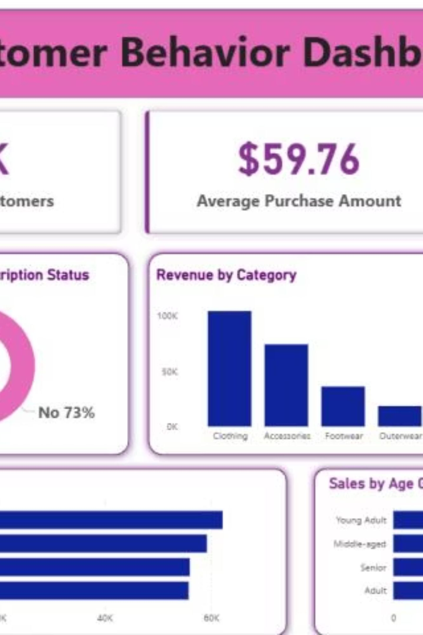
Interactive Dashboard in Power BI
An interactive dashboard was built in Power BI to visually present key insights from the analysis.
The dashboard includes filters for Subscription Status, Gender, Category, and Shipping Type, providing a comprehensive view of customer behavior metrics.

Slide 10

Business Recommendations
1
2
3
Boost Subscriptions
Customer Loyalty
Review Discount Policy
Promote exclusive benefits to increase subscriber base.
Implement programs to reward repeat buyers and foster loyalty.
Optimize discount strategies to balance sales and profit margins.
4
5
Targeted Marketing
Product Positioning
Focus campaigns on high-revenue age groups and express-shipping users.
Highlight top-rated and best-selling products in marketing efforts.

